Slide 1
Nu-2000 흡광율 보정재
Creativity & Confidence
www.atikorea.com

Slide 2

Contents
ATIK 연구소 소개
01
조직도 및 개발역량
02
개발 Project 소개
03
개발 road map
04

Slide 3
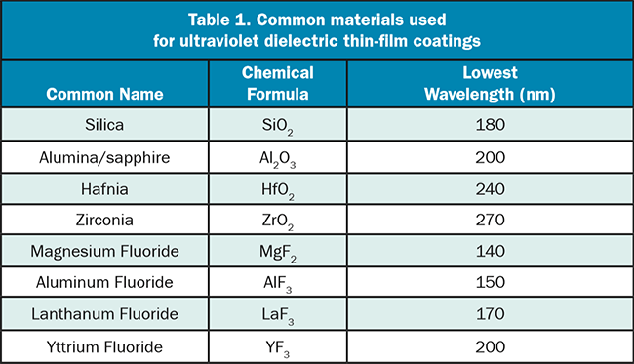
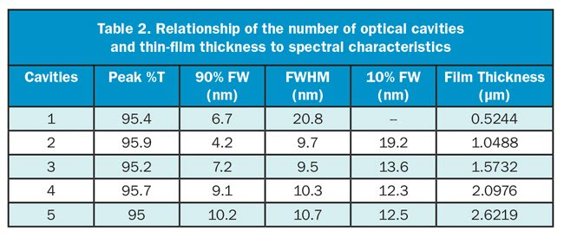
Ultraviolet Filters (Past and Present)
Ultraviolet Filters: Past and Present (https://www.photonics.com/Articles/Ultraviolet_Filters_Past_and_Present/a25446)
ROBERT L. JOHNSON, D.SC. AND SARAH LOCKNAR, PHD, OMEGA OPTICAL INC.
In their earliest forms, UV bandpass filters that were optimized for wavelengths less than 400 nm, such as the Schott UG or the Hoya U-series, were constructed of absorbing compounds in glass. Such filters were limited by the available compounds that can be dissolved or suspended in glass, and they typically had a gradual transition from low to high absorption (Figure 1). These properties in turn limited the applications to ones that do not require sharp or user-defined transitions between transmission and blocking. These limitations were overcome with the development of interference filters, which were made by depositing a multilayer optical coating onto one or more transparent substrates, thus producing a more refined transmission band surrounded by regions of low transmission (the blocking region).

Slide 4
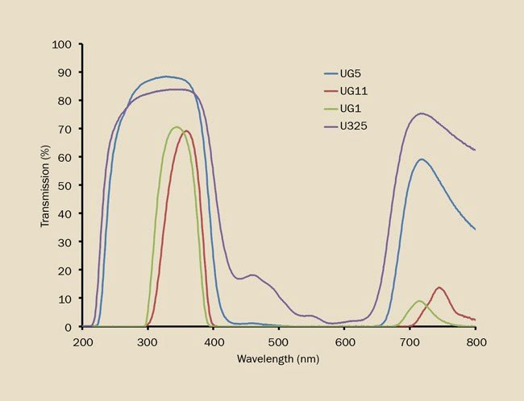
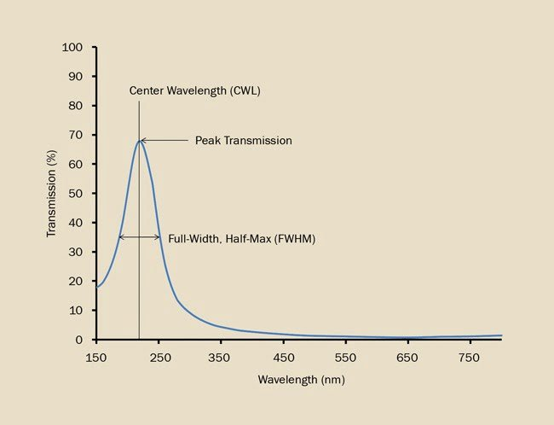
Ultraviolet Filters (Past and Present)
Ultraviolet Filters: Past and Present (https://www.photonics.com/Articles/Ultraviolet_Filters_Past_and_Present/a25446)
Figure 1. UV transmitting glasses are designed to transmit some UV wavelengths while absorbing the bulk of the light in the visible wavelengths.
Figure 2. An induced-transparency filter with three layers in an MDM arrangement.

Slide 5
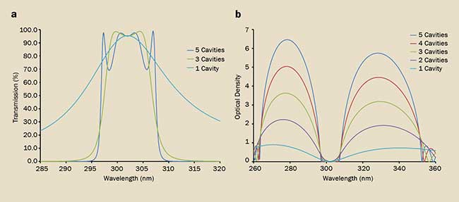
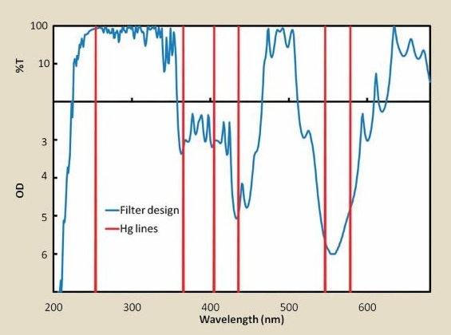
Ultraviolet Filters (Past and Present)
Ultraviolet Filters: Past and Present (https://www.photonics.com/Articles/Ultraviolet_Filters_Past_and_Present/a25446)
Figure 3. Dielectric filters with an increasing number of cavities in the simple FP design. Peak %T is not significantly affected by an increase in the number of cavities (a), but blocking and edge steepness of the bandpass increases with the number of cavities (b).
Figure 4. A dielectric filter designed to transmit the Hg line at 253.7 nm while blocking other spectral lines.

Slide 6
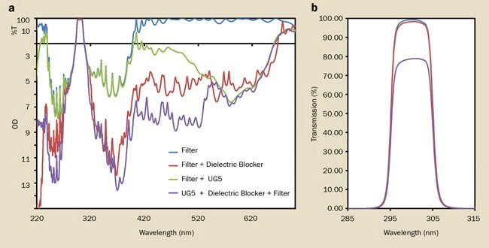
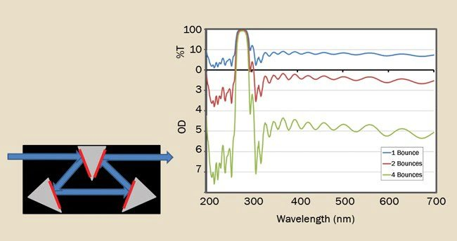
Ultraviolet Filters (Past and Present)
Ultraviolet Filters: Past and Present (https://www.photonics.com/Articles/Ultraviolet_Filters_Past_and_Present/a25446)
Figure 5. Different blocking strategies for a 300-nm dielectric bandpass filter (a) and the effect on %T (b).
Figure 6. A multi-bounce reflected filter assembly at 22.5° angle of incidence.

Slide 8
감사합니다
Creativity & Confidence
www.atikorea.com

